Slide 1
Cement production in Australia (1958-2015)
Time Series Final Project
García Plaza, Manuel & Peñas Bernabéu, Carlos

Slide 2
Index
Data visualization
Box-Cox transformation
Differentiation
Model candidates
Model selection
Likelihood criteria
MSE and MAE
Diagnosis of residuals
Conclusions
Graphical validation of the final model
Predictions

Slide 3
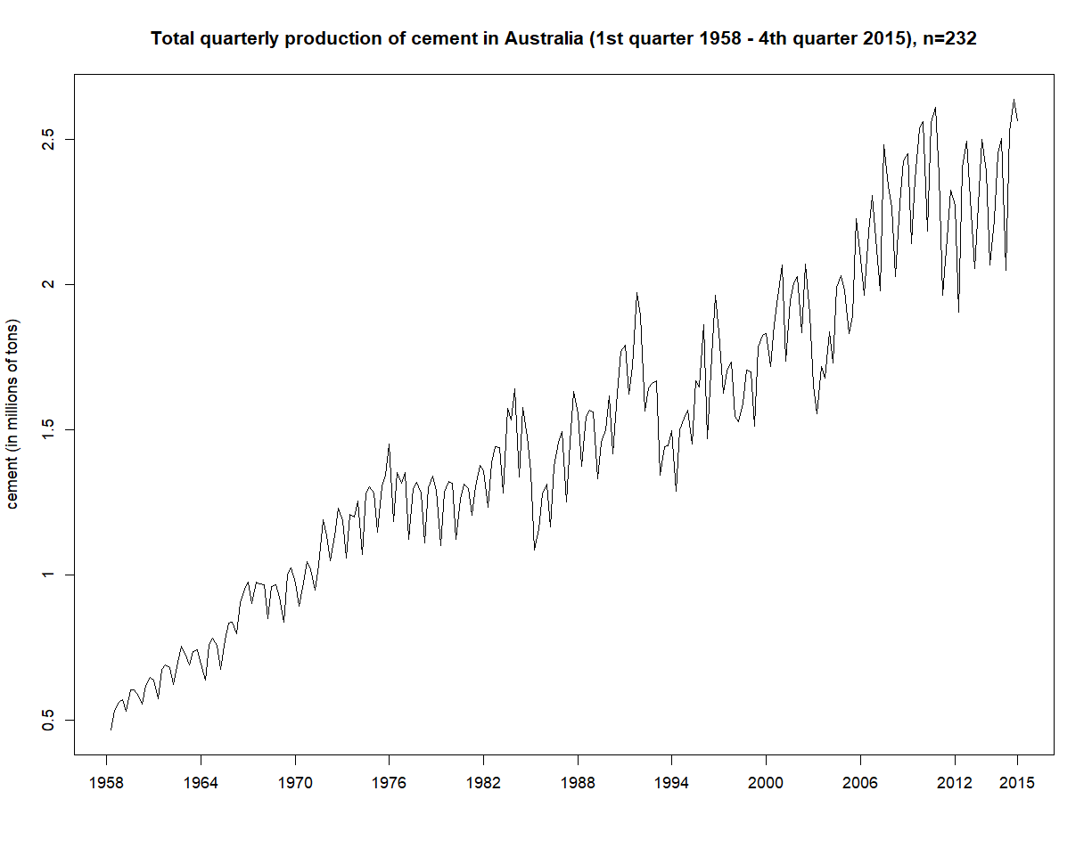
Data visualization
We observe in this first plot:
A trend component
A possible seasonal component in which the period might be one year (4 quarters).
The variance is not constant.

Slide 4
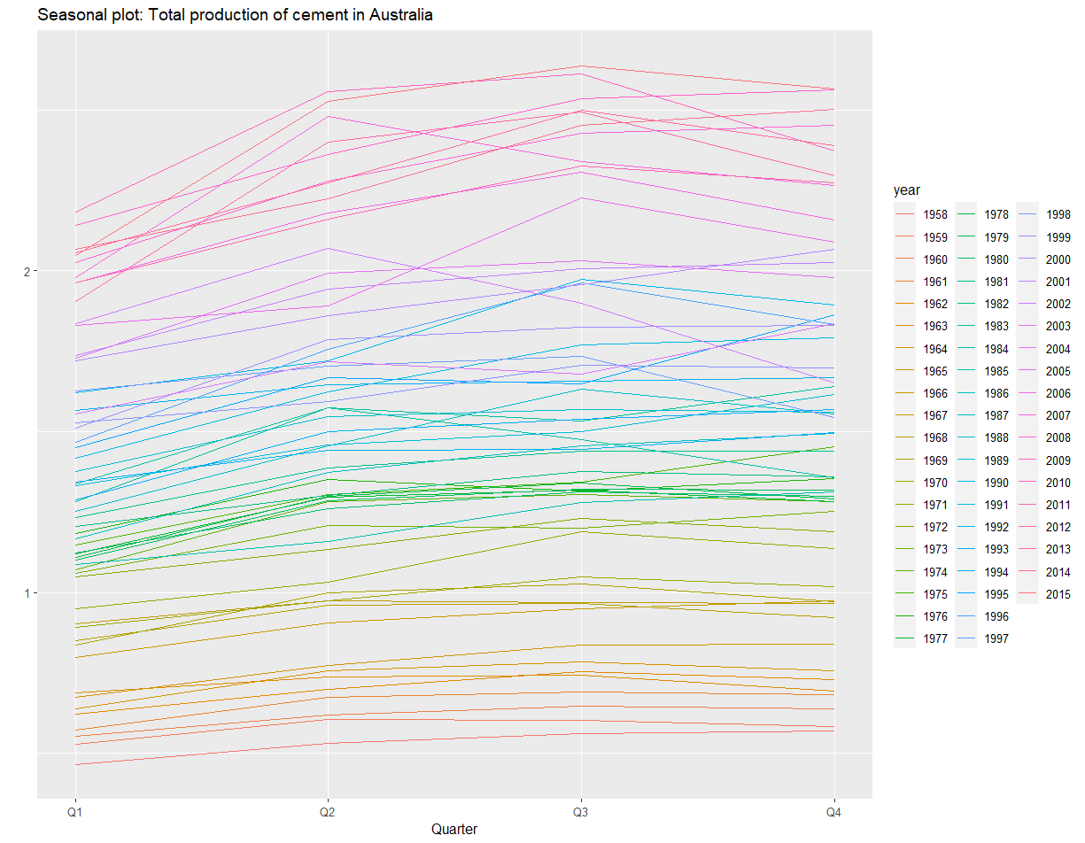
Seasonality
We check that the period is four quarters by plotting the seasonal plot, supposing that s=4 (each colour represents a year).
The conclusions after this plot:
The period is s = 4 (parallel lines).
The variance is not constant, it increases over time (flat lines that become sharp).
There is a trend component, (the height of the lines is greater while we advance in years).

Slide 5
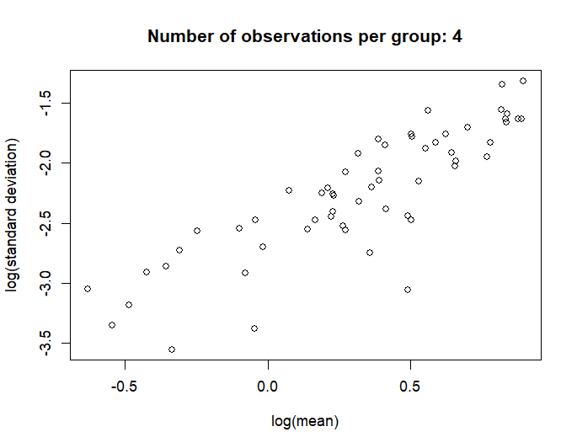
2. Box - Cox transformation
There is a linear relationship between the logarithm of the mean and the logarithm of the standard deviation (each dot represents a year, which is a group of four observations).
Thus, we can apply the Box-Cox transformation in order to stabilize the variance.

Slide 6
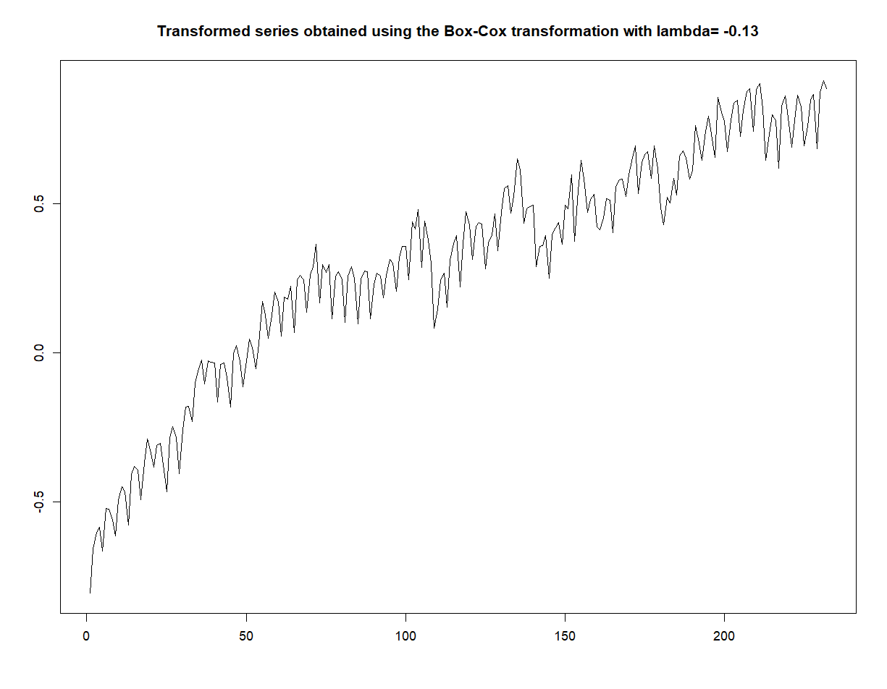
New process {X_{t}} = (X_{t} -1)/𝛌
~
^{𝞴}
By seeing this plot, the variance is now stabilized after transforming X_{t} into X_{t}.
The estimated value of λ is -0.13. This does not suggest to use the logarithmic transformation to remove the heteroskedasticity in the original time series (because λ is not sufficiently close to 0).
~

Slide 7
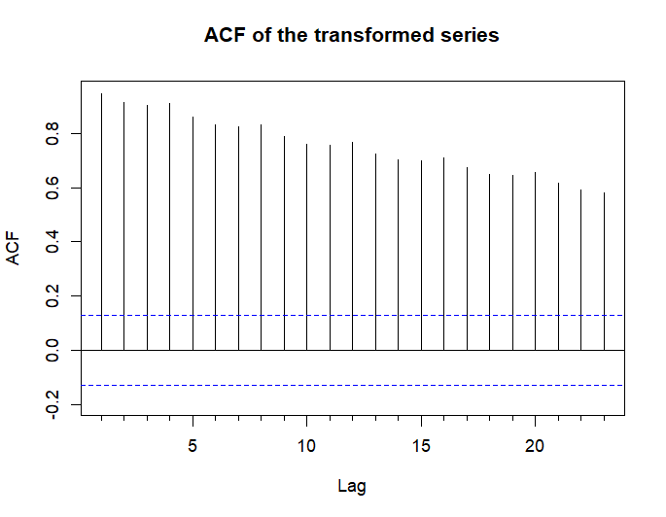
3. Differentiation
As the coefficients of the ACF of the transformed series decay slowly and approximately linearly, it suggests that we have to differentiate it at least once.

Slide 8
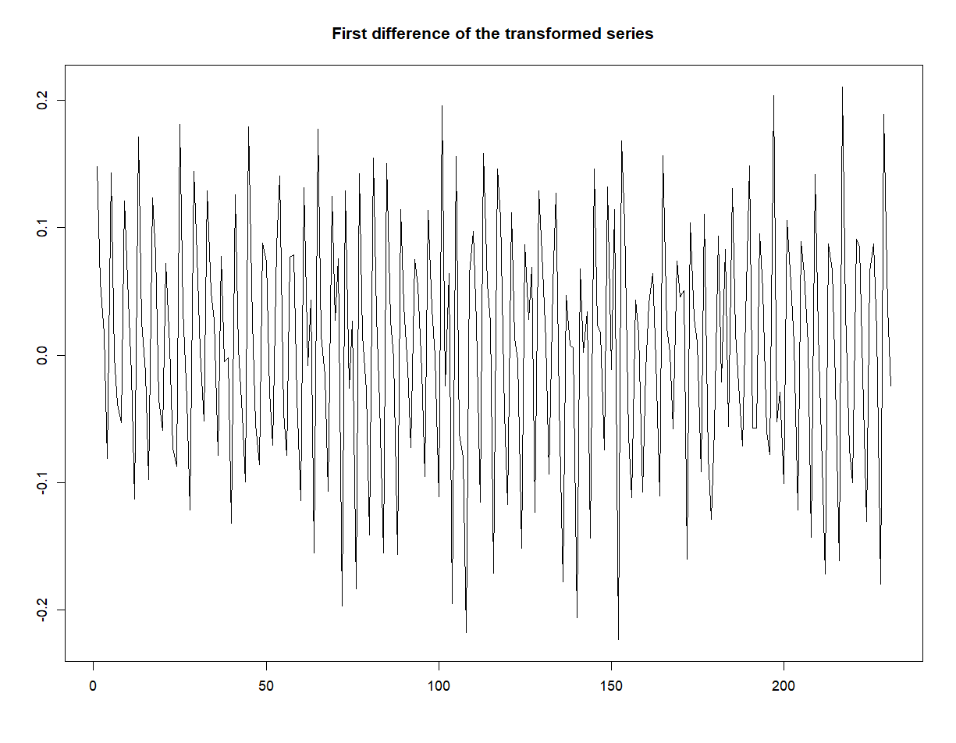
Series {W_{t}}, where W_{t} = ⛛X_{t} = X_{t} - X_{t-1}
~
~
~
After differentiating once, now the mean is apparently constant and zero.
We stop differentiating; this gives a coefficient d=1.

Slide 9
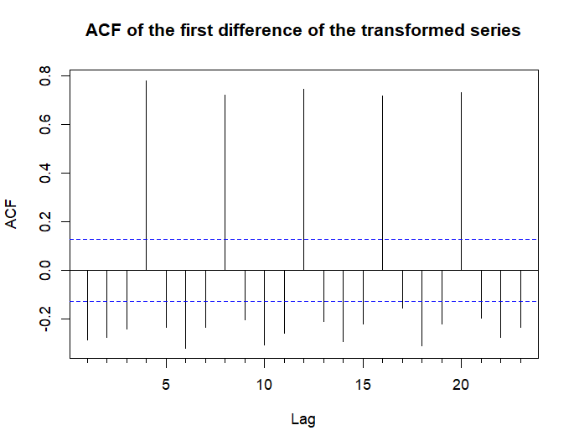
ACF of {W_{t}}
In the ACF of {W_{t}}, we can observe a linear and slow decay of the coefficients of the seasonal lags (h=4,8,12,...). Then, we need to differentiate seasonally at least once.

Slide 10
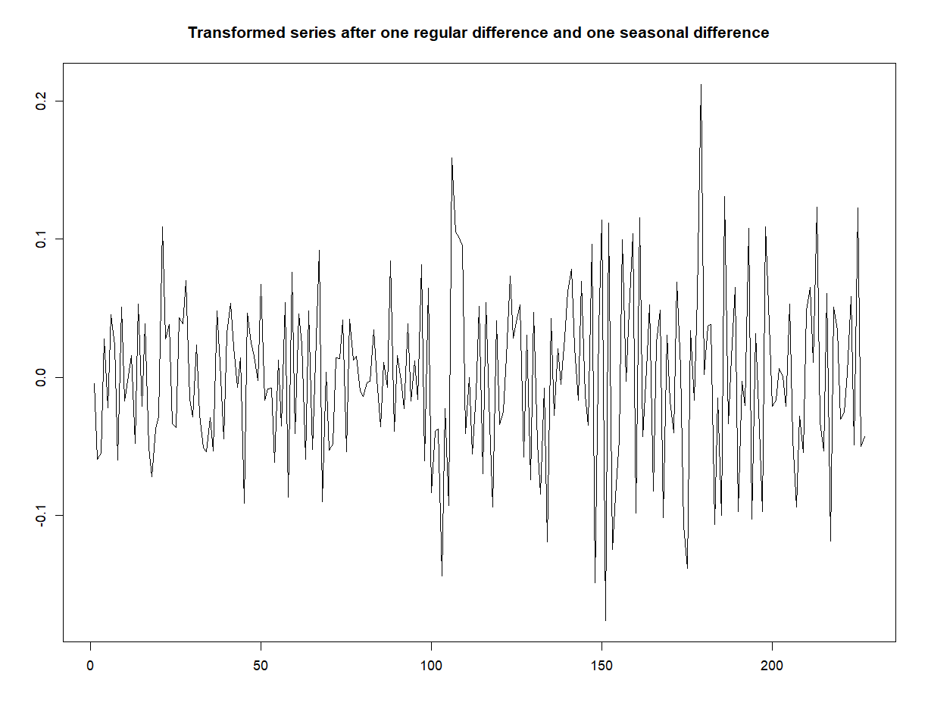
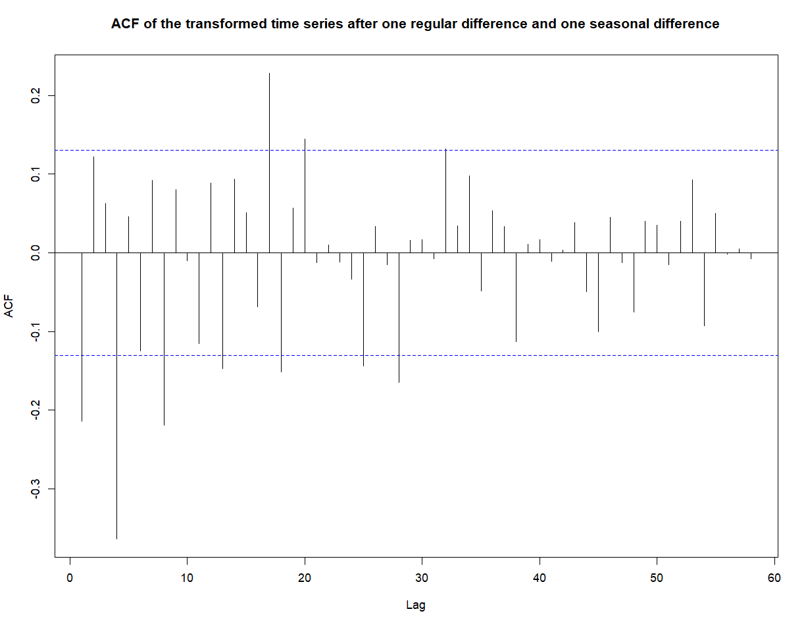
Final time series: {W_{t}}, with W_{t} = ▽₄W_{t} , where ▽₄ = (1 - B⁴)
~
~
The graph and the ACF do not show obvious deviations from stationarity. In fact, the mean is -0.0005275175.

Slide 11
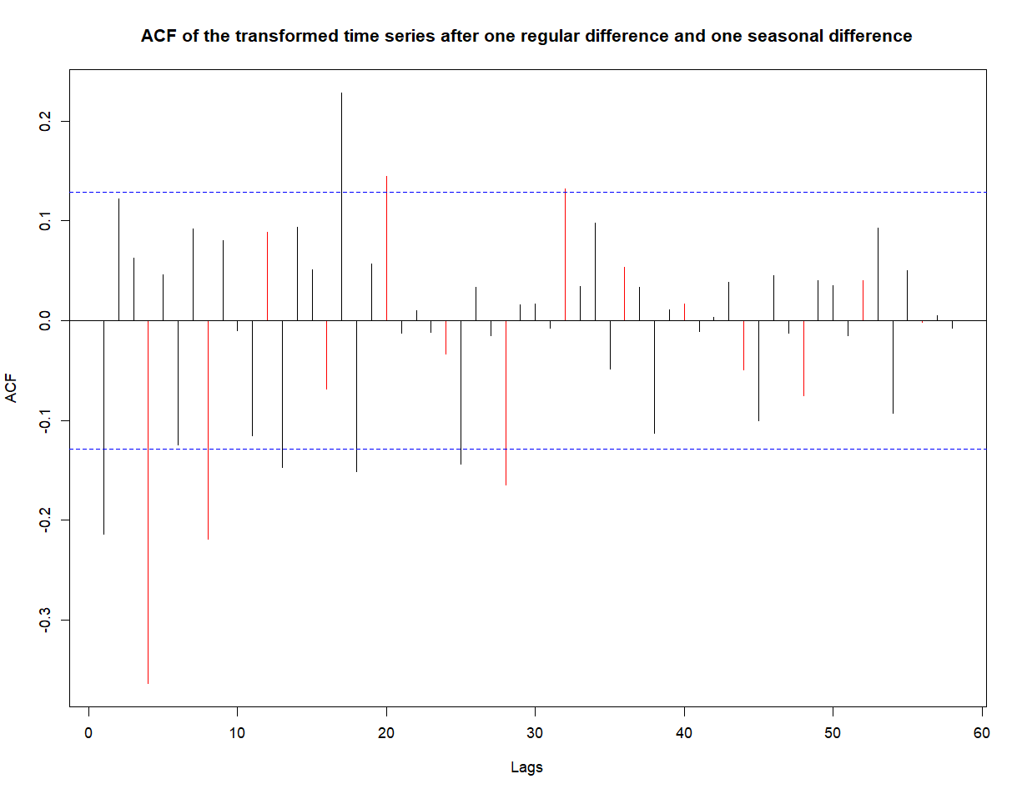
4. Model candidates
ACF of the process {W_t (tilda)}
First lags: we can consider only the first coefficient different from zero or a geometrical decrease.
Seasonal lags: we can consider only 2 coefficients different from zero or geometrical decrease.
Between seasonal lags, the interaction of both parts, there are not many lags to conclude anything clear because the period is very small (s = 4).

Slide 12
Possibilities from the ACF plot
Based on each feature that we have observed in the previous image, these are our first ideas:
For the regular part:
MA(1), based on “only the first coefficient different from zero”
AR or ARMA, based on “geometrical decrease”
For the seasonal part:
MA(2), based on “only 2 coefficients different from zero”
AR or ARMA, based on “geometrical decrease”

Slide 13
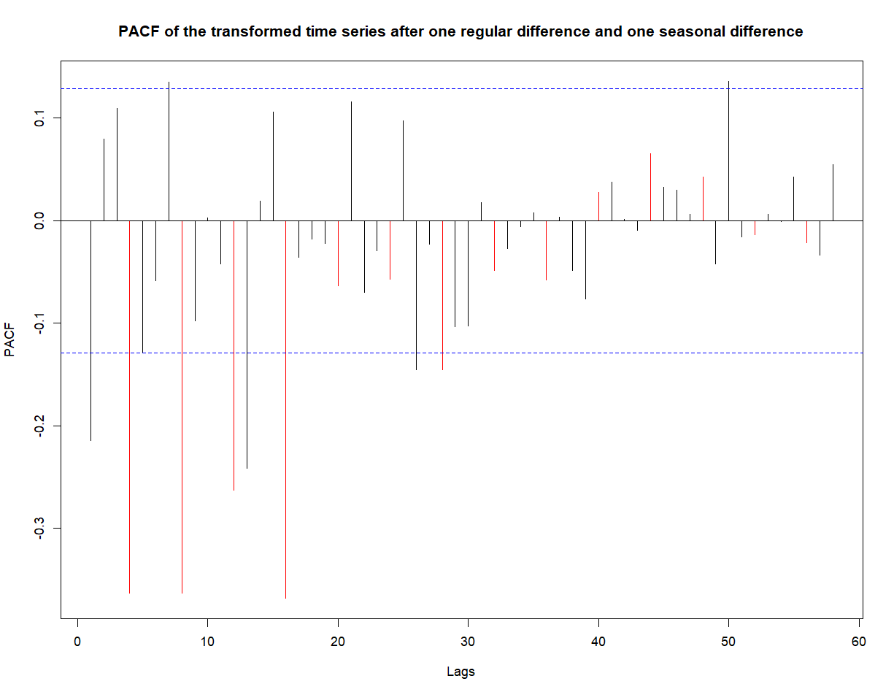
Regular lags: the first coefficient different from zero or geometrical / sinusoidal decrease.
Seasonal lags: clearly, the first four coefficients are different from zero.
Both to the right and to the left of each seasonal lag, we can’t conclude anything due to the small quantity of coefficients.

Slide 14
Possibilities from the PACF plot
Based the features we have observed in the last image, these are our ideas:
For the regular part:
AR(1), based on “the first coefficient different from zero”
MA or ARMA, based on “geometrical / sinusoidal decrease”
For the seasonal part:
AR(4), based on “the first four coefficients are different from zero”

Slide 15
Combination of the possible models
Merging the previous ideas, we propose eleven model candidates:
ARIMA(4,1,0)₄ x (1,1,1)
ARIMA(4,1,0)₄ x (2,1,1)
ARIMA(4,1,0)₄ x (1,1,0)
ARIMA(4,1,0)₄ x (2,1,0)
ARIMA(2,1,2)₄ x (2,1,0)
ARIMA(2,1,2)₄ x (2,1,1)
7. ARIMA(2,1,0)₄ x (2,1,0)
8. ARIMA(2,1,0)₄ x (2,1,1)
9. ARIMA(2,1,2)₄ x (0,1,1)
10. ARIMA(2,1,0)₄ x (0,1,1)
11. ARIMA(4,1,0)₄ x (0,1,1)

Slide 16
5. Model selection
5.1. Likelihood criteria
 | Model 1 | Model 2 | Model 3 | Model 4 | Model 5 | Model 6 | Model 7 | Model 8 | Model 9 | Model 10 | Model 11
AIC | -750.88 | -749.50 | -746.60 | -751.16 | -750.09 | -748.44 | -702.71 | -700.77 | -748.07 | -698.82 | -739.70
AICc | -750.37 | -748.84 | -746.22 | -750.65 | -749.58 | -747.78 | -702.44 | -700.38 | -747.69 | -698.64 | -739.32
BIC | -726.91 | -722.10 | -726.05 | -727.19 | -726.12 | -721.04 | -685.59 | -680.22 | -727.52 | -685.12 | -719.15
Our best model in terms of AIC and AICc is Model 4, and tanking into account BIC, it is Model 9.

Slide 17
5.2. MSE and MAE
 | Model 1 | Model 2 | Model 3 | Model 4 | Model 5 | Model 6 | Model 7 | Model 8 | Model 9 | Model 10 | Model 11
MSE | 0.0048 | 0.0049 | 0.0048 | 0.0048 | 0.0045 | 0.0047 | 0.0062 | 0.0063 | 0.0062 | 0.0064 | 0.0063
MAE | 0.0416 | 0.0413 | 0.0425 | 0.0409 | 0.0402 | 0.0409 | 0.0463 | 0.0465 | 0.0462 | 0.0470 | 0.0468
According to the mean squared error and the mean absolute error, Model 5 is the best one in both metrics.

Slide 18
5.3. Diagnosis of the residuals
Non Parametric Tests
Turning Point Test | Difference-sign test | Rank test | Ljung-Box Test (k=8)
 | Statistic | P-value | Statistic | P-value | Statistic | P-value | Statistic | P-Value
Model 4 | 1.6153 | 0.1062 | 1.7021 | 0.0887 | 0.7041 | 0.4814 | 2.5425 | 0.1108
Model 5 | 0.6774 | 0.4982 | 1.929 | 0.0537 | 1.024 | 0.3059 | 4.3271 | 0.0375
Model 9 | 1.1985 | 0.2307 | 1.0212 | 0.3071 | 1.0223 | 0.3066 | 9.4011 | 0.0091
As the p-value of the Ljung-Box test for models 5 and 9 is lower than the significance level, we can reject the null hypothesis (“the residuals are independent and identically distributed”). We can’t conclude anything from the non parametric tests because every p-value is greater than the significance level

Slide 19
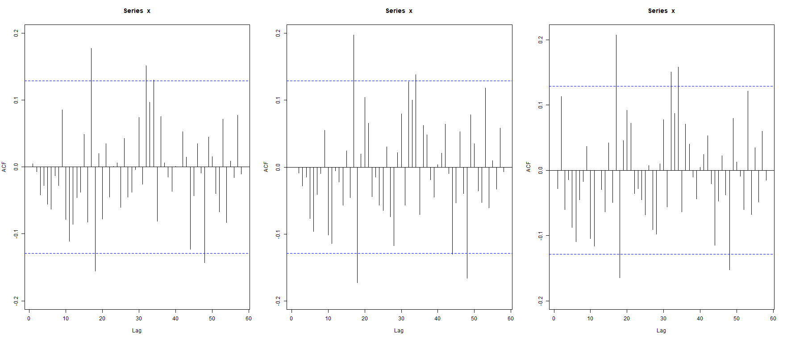
Non - null coefficients of the ACF
Model 4
Model 5
Model 9
 | n | h = n/4 | Bound | Number of coefficients out of bounds | % of coefficients out of bounds
models 4,5,9 | 232 | 58 | ± 0.13 | 5 | 8.62

Slide 20
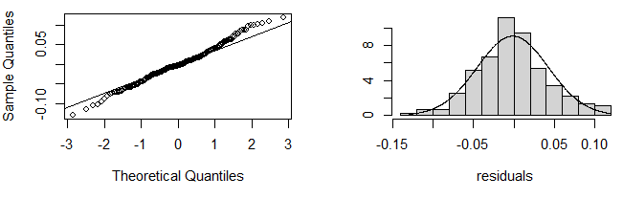
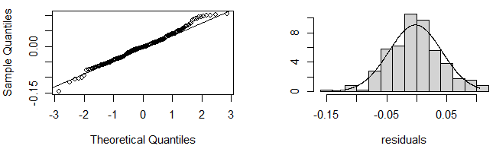
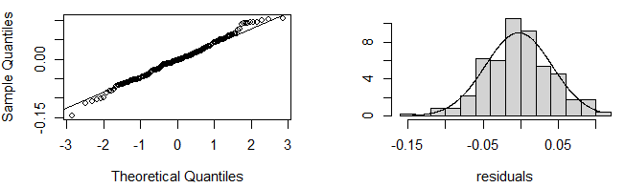
Normality of the residuals
Model 4
Model 5
Model 9
 | Shapiro-Wilks | Lilliefors | Pearson Chi-Square |  | Shapiro - Wilks | Lilliefors | Pearson Chi-Square |  | Shapiro - Wilks | Lilliefors | Pearson Chi - Square
Statistic | 0.9915 | 0.0550 | 19.8448 |  | 0.9913 | 0.0472 | 19.2241 |  | 0.9931 | 0.0452 | 17.9828
p-value | 0.1982 | 0.0850 | 0.1780 |  | 0.1801 | 0.2358 | 0.2038 |  | 0.3529 | 0.2958 | 0.2636

Slide 21
6. Conclusions
In general, the tests do not “make differences” between models. In fact, it seems that the residuals are normally distributed.
The test based on the ACF of the residuals is confusing because there are some values that could be considered borderlines. Ljung-Box test is the only one that provides statistical evidence that the residuals of models 5 and 9 are not iid.
Thus, our final model will be Model 4, which was {X_{t}}~ARIMA(4,1,0)₄ x (2,1,0). The expression of the model, with his coefficients, is:
~
~
(1 + 0.6208B⁴ + B⁸ + 0.4751B¹² + 0.2461B¹⁶)(1 + 0.1995B - 0.3481B²)(1-B⁴)(1-B)X_{t} = Y_{t}
with {Y_{t}} ~ N(0,σ²) and σ² = 0.00202 .

Slide 22
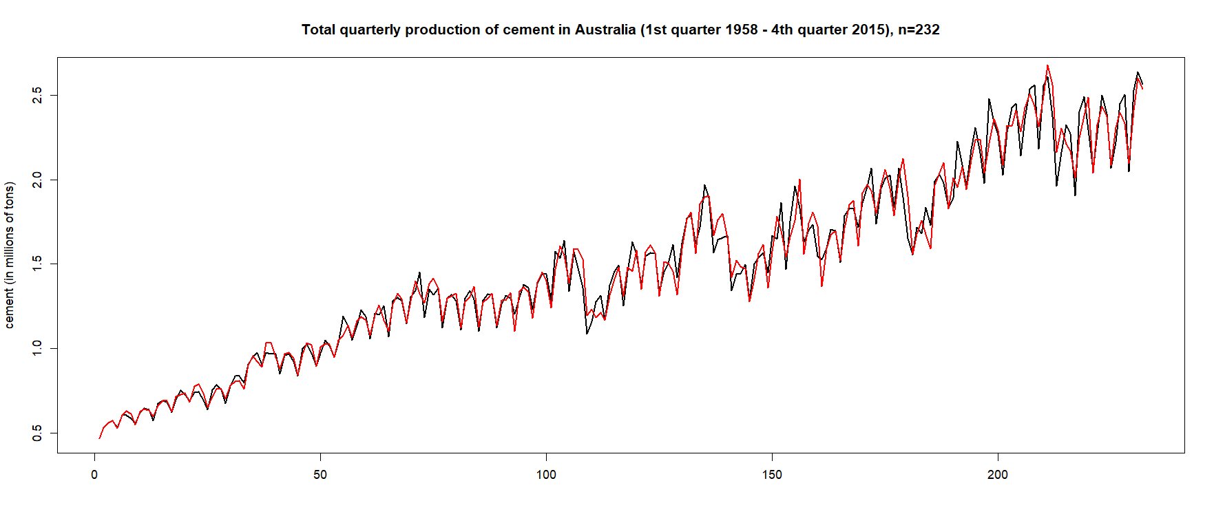
7. Graphical validation of the final model
In black we have our observations.
In red, we have the fitted values according to the chosen model.

Slide 23
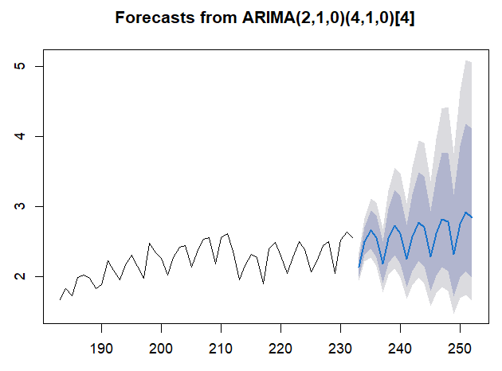
6. Predictions
Predicted values of the transformed original series
 | 1st qtr. | 2nd qtr. | 3rd qtr. | 4th qtr.
2016 | 2.139 | 2.5016 | 2.6617 | 2.5598
2017 | 2.1819 | 2.5492 | 2.7303 | 2.617
2018 | 2.2518 | 2.5683 | 2.7798 | 2.7078
2019 | 2.2885 | 2.6200 | 2.8226 | 2.7857
2020 | 2.3220 | 2.7589 | 2.9291 | 2.8399
Note: the predictions are given on the transformed original series by Box-Cox.

